Slide 1


Student Financial Aid
Attending School
2017-2018
Or
2018-2019

Slide 2
Going to College is Exciting!
  Academic Preparation
  Does the campus have my major?
  Campus Climate
  Is this campus a good fit?
  Financial Preparation
  Can I afford to go to this college?
  Do I have any money saved?
  What will the net price (cost minus financial aid) be?
  Check out each campus’ Net Price Calculator
  More information at studentaid.ed.gov
Notes:
Getting ready to go to college is exciting.
You’ve been preparing academically and you’ve looked for some campuses that meet your academic needs – have your major – etc.
Perhaps you’ve visited some campuses and identified which one (or ones) seem like a good fit for you.
Now you have to think about paying for college.
These are questions to ask.
All campuses have to have a Net Price Calculator – check out their websites for more information.
You can also visit studentaid.ed.gov for more information about college costs and characteristics
Let’s get started by talking about those college costs

Slide 3










Tuition
Required Fees
Room
Meals (Board)
Books & Supplies
Transportation
Personal & Miscellaneous
Loan Fees
Notes:
Let’s talk about what makes up a college’s cost of attendance.
Tuition buys you a seat in a classroom or access to an on-line course.
Colleges often charge students for various campus facilities and services. Examples:
Student health
Student recreation programs and facilities and athletics
Student union buildings
Performing and fine arts programs
Room – either on campus or off campus in an apartment or house. If the student lives at home, you do not have to pay additional rent out of pocket, of course.
Meals – either the college’s meal plan or cooking for yourself. Even students who commute to campus every day will have some meal expenses.

Slide 4





Financial Aid Basics
Gift Aid – Grants & Scholarships
Self Help – Employment & loans
Merit-Based Aid
Need-Based Aid
Family is primarily responsible for educational expenses
Annual application
Notes:
Financial aid comes in two forms
Gift aid and Self Help
Gift aid is what is commonly referred to as “free money.”
Includes grants and scholarships.
Scholarships, although they don’t have to be repaid, may have criteria the student has to meet to receive or renew the scholarship assistance.
What do you say when offered a gift? THANK YOU – that’s also what you say when offered a grant or scholarship!
Self Help aid is just what is sounds like – you are helping yourself in some way.
Includes student employment through the Federal Work Study program – which we’ll discuss a little later
And
Educational loans – student and possibly parent borrowing against the student’s future earnings.

Slide 5
Basic Principle of Financial Aid
Cost of Attendance (COA) at Institution
- Expected Family Contribution (EFC)
Eligibility for Need-Based Funds at Institution
A family’s ability to pay must be evaluated in an equitable and consistent manner while recognizing special circumstances that may alter a family’s ability to pay. The FAFSA is used for this purpose for federal student aid programs.
Notes:
This is the basic financial aid formula.
Cost of Attendance minus the Expected Family Contribution (calculated by the Free Application for Federal Student Aid) equals Eligibility for Need-based financial aid.
Cost of Attendance includes tuition, fees, room, board, books & supplies, transportation, personal and miscellaneous expenses.
The federal financial aid analysis formula attempts to determine the family’s ability to pay for educational expenses, based on the FAFSA data.
Need-based aid means you have to demonstrate eligibility for that type of financial aid program.

Slide 6
General Eligibility Requirements for Federal Student Financial Aid
Regular student enrolled in a eligible program at an eligible college as a regular student
Have high school diploma or equivalent or complete a homeschool program approved under state law
Be a US citizen or eligible noncitizen
Have a valid Social Security number
If male, must be registered with Selective Service
Notes:
Financial aid programs are not just for recent high school graduates.
Adult students can receive financial aid also.
These are some of the general eligibility requirements:
Be a regular student enrolled in an eligible program (for purposes of obtaining a degree or certificate) at an eligible institution
Have a high school diploma, its equivalent, or have been home-schooled
Be a U S citizen or eligible noncitizen
Have a valid social security number
Be registered with Selective Service (males) – this applies to students who were identified as “male” on their birth certificate. A transgender man (identified as female at birth) does not have to register but a transgender woman (identified as male at birth) does.

Slide 7
General Eligibility Requirements for Financial Aid
Not be in default on federal loan
Not owe a repayment on a federal grant
Not have property subject to lien for debt owed to US
Not have been convicted or pled no contest to a crime involving fraud in obtaining federal aid funds
Not have borrowed in excess of annual or cumulative loan limits
Make satisfactory academic progress
Notes:
Not be in default on a federal Title IV loan
Not owe a repayment on a federal Title IV grant
Not have property subject to lien for debt owed to the United States government (like a lien because you failed to pay federal tax debt)
Not have been convicted or pled no contest to a crime involving fraud in obtaining federal student financial aid funds
Not have borrowed in excess of annual or cumulative loan limits
Make satisfactory academic progress toward the completion of your program of study.
Each campus establishes its own satisfactory academic progress policy.

Slide 8

Common Financial Aid Forms
Free Application for Federal Student Aid (FAFSA)
  fafsa.gov
College Scholarship Service Profile Form
  collegeboard.com
Institutional Financial Aid Application
Scholarship Applications
Notes:
Some colleges require you to complete an additional financial aid application – the College Scholarship Service Profile Form. You can find out about the requirement and the form through your campus financial aid office.
Some colleges also ask you to complete an Institutional Financial Aid application.
You may need to submit special applications for specific scholarships.

Slide 9
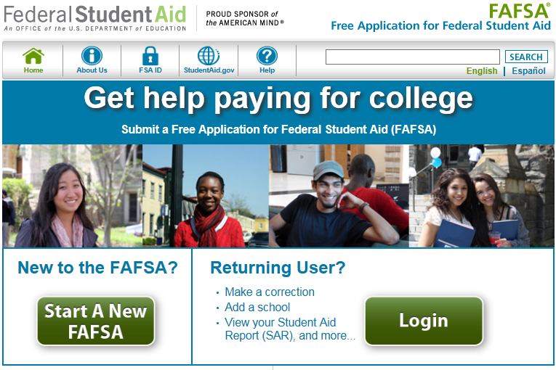
Free Application for Federal Student Aid (FAFSA)
Notes:
Home page for FAFSA.gov
This is where you start the application process.

Slide 10
Apply for your FSA ID before completing the FAFSA
Students and at least one parent whose information will be listed on the FAFSA need to sign electronic documents using the FSA ID.
Notes:
The Free Application for Federal Student Aid (FAFSA) is the form you must complete to be considered for all federal student aid – grants, employment, loans.
Virtually every college requires that you complete the FAFSA.
Apply on-line at www.fafsa.gov
The student and at least one parent whose information is included on the FAFSA must electronically sign the FAFSA using the FSA ID.
You can apply for your FSA ID before completing the FAFSA
You should not have to pay to complete the FAFSA. If you are asked for credit card information, you are on the wrong website. Be sure it is GOV – for Government – at the end of the address.
You can safely link to the correct web address through CFNC.org – Online Applications tab.

Slide 11
Which year’s FAFSA do I need?
Enrolling for this term | Use this FAFSA
Spring 2018 | 2017-18 FAFSA
Summer 2018 | Check with your campus – you may need the 2017-18 FAFSA or the 2018-19 FAFSA
Fall 2018/Spring 2019 | 2018-19 FAFSA
Notes:
Remember that you must complete a new FAFSA each award year.

Slide 12



Who Provides information on the FAFSA?
Dependent student:
Student and parent(s)
Independent student:
Student (and spouse if married)

Slide 13
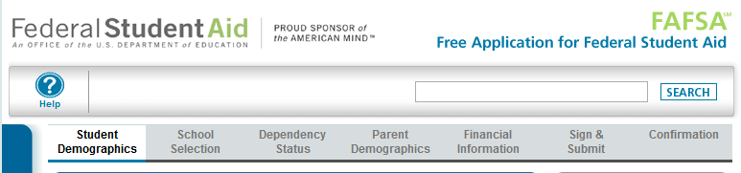
Student Demographics
School Selection
Dependency Status
Parent Demographics
Financial Information (both the student and parent(s)
Signature and Confirmation
Notes:
The FAFSA should take less than one hour to complete depending on your answers and whether or not you have the necessary information available.
You don't have to complete the entire FAFSA at one time. You can save the application for up to 45 days.
If you start a FAFSA and decide you don't want to submit the FAFSA, you will also have the option to delete the application. But remember that your eligibility for federal student aid cannot be determined without a submitted FAFSA.
To complete the Free Application for Federal Student Aid (FAFSA), you will need:
Your Social Security Number
Your Alien Registration Number (if you are not a U.S. citizen)
Federal income tax returns, W-2s, and other records of money earned for the year listed on the FAFSA.
(Note: You may be able to transfer your federal tax return information into your FAFSA using the IRS Data Retrieval Tool.)
Bank statements and records of investments (if applicable)
Records of untaxed income (if applicable)
Your FSA ID to sign electronically. If you are a dependent student, then you will also need most of the above information for your parent(s). And one of the parents listed on your FAFSA must have an FSA ID to electronically sign the form.

Slide 14
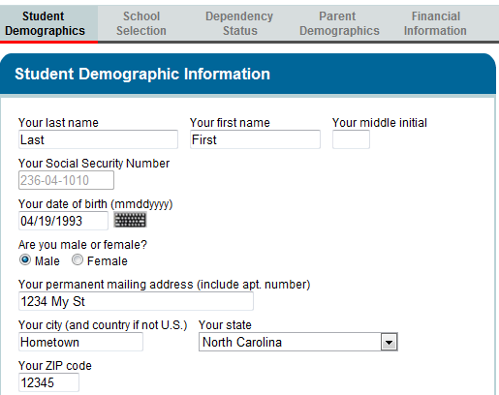
Student Demographics
Name must match Social Security Administration records
Correct and valid Social Security Number
Date of Birth must match Social Security Administration records
Gender (at birth)
Permanent address

Slide 15
Citizenship Requirements
U.S. citizen or U.S. National
Eligible Noncitizen
  U.S. permanent residents
  Citizens of Freely Associated States, Federated States of Micronesia, Republics of Palau and Marshall Islands
  Asylum Granted
  Parolee for at least one year
  Refugees
  Victim of Human Trafficking
  Battered immigrants-qualified aliens
  Conditional entrants
  Cuban-Haitian entrant
Eligible categories may change, so always check at fafsa.gov
Notes:
Eligible noncitizens include:
U.S. permanent resident, with a Permanent Resident Card (I-551), or a conditional permanent resident with a Conditional Green Card (I-551C)
Other eligible noncitizen with an Arrival-Departure Record (I-94) from the Department of Homeland Security showing any one of the following designations: "Refugee," "Asylum Granted," "Parolee” (I-94 confirms that you were paroled for a minimum of one year and status has not expired), T-Visa holder (T-1, T-2, T-3,etc.), or "Cuban-Haitian Entrant"
The holder of a valid certification or eligibility letter from the Department of Health and Human Services showing a designation of "Victim of human trafficking"
A resident of the Republic of Palau (PW), the Republic of the Marshall Islands (MH), or the Federated States of Micronesia (FM)
A Canadian-born Native American under terms of the Jay Treaty
Select Neither citizen nor eligible noncitizen if you are in the U.S. on:
A F1 or F2 student visa
A J1 or J2 exchange visitor visa
A G series visa (pertaining to international organizations)
Other categories not included under U.S. citizen and eligible noncitizen
Student's Alien Registration Number
Question 15
Enter your eight or nine-digit Alien Registration Number. If your Alien Registration Number is eight digits, type a zero before the Alien Registration Number. Do not enter the "A" before the number.
An answer is not required if you are a citizen of the Federated States of Micronesia, the Marshall Islands, or Palau.

Slide 16
I’m a citizen, but my parents . . .
Students who are citizens or eligible noncitizens can still receive federal and state financial aid
Parents who are not citizens should
  Include their income and assets on the FAFSA
  Use nine zeros as their Social Security numbers

Slide 17





If you answer “No” you are dependent for financial aid purposes
Born before 1/1/1994 (for 2017-18 FAFSA)
Born before 1/1/1995 (for 2018-19 FAFSA)
Graduate or Professional Student
Provide the support for your own children or other dependents
Active Duty or Veteran
Notes:
Dependent student answers NO to all of these questions
Born before January 1, 1994 f0r 2017-18 FAFSA and before January 1, 1995 for 2018-19 FAFSA?
Working on Masters or Doctorate or Professional Degree for the applicable academic year
Married?
Has children or other dependents of his/her own that he/she supports (more than 50%)
On active duty in the U.S. Armed Forces?
A veteran of the U.S. Armed Forces?
Student’s children – student must provide more than 50% of the child’s support.
Support can include income from work, untaxed income and benefits, child support received or paid, health insurance coverage, support in kind, like food, shelter, clothing, etc.
In order to include people other than the student’s spouse or children as dependents, the other person has to live with the student and the student has to provide more than 50% of the person’s support

Slide 18




If you answer “No” you are dependent for financial aid purposes
Any time since age 13
Both parents deceased
Dependent or Ward of the Court
Emancipated Minor
Unaccompanied youth who are homeless or at risk of homelessness
Has a legal guardian other than parent or stepparent
In foster care any time age 13 or older

Slide 19
Parent Marital Status
What is your parent’s marital status as of the day you complete the FAFSA?
Married or Remarried
Never Married
Divorced or Separated
Widowed
Unmarried and both parents living together
Notes:
If your parents are married, provide information about both parents.
If your parent is never married, provide information about that parent (New for 2014-2015)
If your parents have divorced (not remarried) or separated and are not living at the same residence, provide information about the parent that you lived with most during the last 12 months. If you did not live with one parent more than the other, provide information about the parent who provided most of your financial support during the last 12 months.
If your parents have divorced or are separated but still live at the same residence, provide information about both parents.
If your parent has remarried after being widowed or divorced, provide information about both your parent and your stepparent.
If your parent is widowed provide information about that parent.
If your parents are unmarried and both parents live together, provide logic about both parents
If you have a legal guardian, you cannot use your legal guardian’s information on your application. A legal guardian is not considered a parent in the financial aid process.
If you have foster parents, you cannot use your foster parents’ information on your application. A foster parent is not considered a parent in the financial aid process.
If you were adopted, follow the instructions above for parents, based on your adoptive parents’ current marital status.
Note: The following people are not considered parents on this form unless they have legally adopted you: grandparents, foster parents, legal guardians, older brothers or sisters, and uncles or aunts.
Following the U.S. Supreme Court decision on June 26, 2013 overturning the Federal Defense of Marriage Act, the Department of Education is reviewing the recent Supreme Court decision on DOMA and its impact on the federal student aid programs. They will provide information and guidance on this matter as soon as it is available.

Slide 20
Who are your “FAFSA” Parents?
Biological or adoptive parents married to each other
Biological or adoptive parents who are not married to each other and are living together
A single parent who is widowed or never married
Separated/Divorced parents not living together – list the parent with whom the student lived most often – include stepparent information if the parent has remarried
Don’t forget your stepparent’s information
Notes:
New Definition of Parents - Dependent students will be required to include on the FAFSA income and other information from the dependent student’s legal parents (biological or adoptive) regardless of the parents’ marital status or gender, if those parents live together.
•Biological Parents or Same Sex Parents (regardless of state authority related to marriage) should use this response if appropriate
•Smart Logic will modify follow-up questions with gender-neutral identifiers: Parent 1 and Parent 2 instead of mother and father
If your parents are divorced and you spend an equal amount of time with each of them, then you should answer FAFSA questions about the parent who provided the most financial support to you in the 12 previous months.
Following the U.S. Supreme Court decision on June 26, 2013 overturning the Federal Defense of Marriage Act, the Department of Education is reviewing the recent Supreme Court decision on DOMA and its impact on the federal student aid programs. They will provide information and guidance on this matter as soon as it is available.

Slide 21

Household Information
Student
Student’s parent(s)
Parent(s)’ other children if they will receive more than half of their support from the parent or would be considered “dependent” if they filed a FAFSA
Other people who now live with the parent(s) and who will receive more than half of their support from the parent(s) and will continue to receive that support

Slide 22
Parent and Student FAFSA Information
Student’s Adjusted Gross Income, earnings from work, tax liability - from IRS form
Untaxed Income
Other financial information
Asset Information – including
  Cash, savings, checking accounts
  Other real estate and investments
  Business (Small family business – not reported)
  Investment Farm (Family farm – not reported)

Slide 23

Student and Parent Income Information
Students and parents provide information about taxable and untaxed income and benefits when filing the FAFSA
Some tax filers may transfer data directly from the IRS using the IRS Data Retrieval Tool (IRS DRT)
Not all tax filers are eligible to use the IRS DRT
Using IRS DRT is the easiest
way to provide income
information on the FAFSA
Notes:
The IRS Data Retrieval Tool allows students and parents to access the IRS tax return information needed to complete the Free Application for Federal Student Aid (FAFSA), and transfer the data directly into their FAFSA from the IRS Web site.
(Note: There are several scenarios in which you might not be given the option to use the IRS Data Retrieval Tool, including if you are not eligible to use it.)

Slide 24
Means-Tested Benefits Questions
If you, your parents, or anyone in your parents’ household receive benefits from any of these federal programs, you may not need to provide a lot of income information on the FAFSA
Supplemental Security Income | Medicaid
Free or Reduced School Lunch | SNAP
TANF | WIC
Notes:
Who answers this question?
The parents of a dependent student.
The student if they are independent.

Slide 25
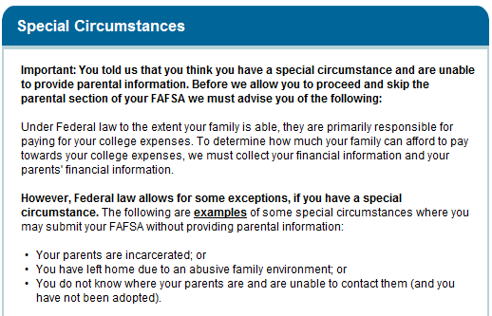
Special Circumstances
Unable to provide parental information
Student is instructed to complete the FAFSA with his/her financial information – submit it without parental information – and then to contact the Campus Financial Aid Office for further instruction
Notes:
Text of advice FAFSA.gov website gives student in this situation:
Review the following to continue.
Student has special circumstances:
1.We will allow you to submit your FAFSA without parental information, however your FAFSA will not be considered complete.
2.Because your FAFSA is not considered complete, we will not calculate your Expected Family Contribution (EFC) which is the index used by colleges to determine how much student aid you are eligible to receive.
3.If you are approaching any deadlines for your state, college, or scholarship aid, you may want to contact your financial aid administrator before submitting your FAFSA without parental data.
4.Once you submit your FAFSA without parental data, you must follow up with the financial aid administrator at the college you plan to attend, in order to complete your FAFSA and receive an EFC. Also, note the following:
•Under Federal law, only your financial aid administrator has the authority to decide whether or not you must provide parental information on your FAFSA.
•You will have to provide documentation to verify your situation. Gather as much written evidence of your situation as you can. Written evidence may include court or law enforcement documents, letters from a clergy member, school counselor or social worker, and/or any other relevant data that explains your special circumstance.
•After reviewing your circumstances carefully, your financial aid administrator will decide if you must provide parental information or if your circumstances allow you to proceed without providing parental data. Your financial aid administrator's decision is final and can not be appealed to Federal Student Aid.
Student does not have special circumstance, but still is not providing parental information (parents refuse, for example):
Students that do not have a special circumstance and are unable to provide parental information normally do not qualify for federal student aid.
However, in situations where your parent refuses to provide their information on the FAFSA and refuses to provide you with any financial support, there is an exception that allows a student to submit the FAFSA without parental information and receive an Unsubsidized Stafford Loan only.
If you would like to contact the financial aid administrator at your college about receiving only the Unsubsidized Stafford Loan, select "I am submitting my FAFSA to apply for an unsubsidized loan only" and click Next to get additional information.

Slide 26
Common FAFSA Errors
Mismatch on parent and student names, Social Security numbers, and dates of birth
Misreporting divorced and remarried parental information
Missing some income earned by parents or stepparents
Missing some untaxed income
Misreporting U.S. federal income taxes paid
Household size errors
Number of household members enrolled in college
Notes:
The student’s name and date of birth must match his/her Social Security Administration records.
The parent’s name and date of birth must match his/her Social Security Administration records.
Listing the wrong parents or forgetting to include a stepparent’s income and assets
Untaxed income – especially contributions to tax-deferred pensions
Reporting tax withheld instead of the actual tax liability
Including too many people in the household
Only students attending college at least half-time and working on a degree or certificate should be listed – and parents are to be EXCLUDED

Slide 27
After you submit your FAFSA
Student Aid Report
  Includes an estimate for Federal Pell Grant and Federal Direct Loan eligibility
  Links to College Navigator for detailed information about the institutions selected, including graduation, retention and transfer-out rates
Campus financial aid office gets your information

Slide 28
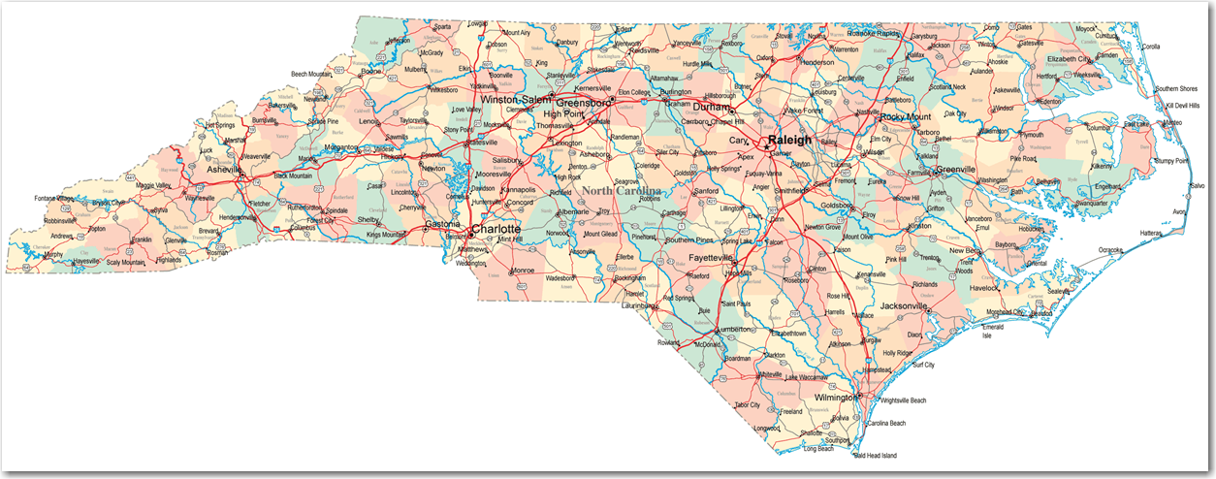
FAFSA Help
FAFSA Day across the state in October
Many campuses hold special days for local students to complete the FAFSA with their help.
Notes:
28

Slide 29
Additional Tips
Apply Early (as soon after October 1 as possible)
Meet your college’s deadlines
Do not wait until you are admitted
Complete all questions accurately
Save your FAFSA answers for your own records
Save your Confirmation Page for your own records
Notes:
Some general tips about completing the FAFSA
Apply early – you can apply after October 1 of your senior year of high school. So if you’ll be a freshman in the 2017-18 year, you’ll fill it out in October of 2016.
Some colleges have very early financial aid deadlines – be sure to meet those
Do not wait until you are admitted to complete the FAFSA. You can list up to 10 colleges on the FAFSA on the web.
Complete all questions accurately.
Print and save the FAFSA for your own records.
Students may contact FSAIC to request up to 3 paper FAFSAs by calling 1-800-4-FED-AID (1-800-433-3243)

Slide 30

Types of Financial Aid
Federal Grants
State Grants
Institutional Grants and Scholarships
Scholarships and Grants from other organizations
Federal Loans – remember that loans must be repaid
Alternative Loans – remember that loans must be repaid
Learn more at studentaid.gov or CFNC.org
Notes:
Federal Grants –
Federal Pell Grants go to undergraduate students with the lowest Expected Family Contribution
Federal Supplemental Grant (FSEOG) are targeted to the neediest students on campus and are awarded by the campus financial aid office.
State Grants are sector-based
NC Community College Grant
UNC Need-Based Grant
NC Need-Based Scholarship (independent, private campuses)
Education Lottery Scholarship (NC CC & UNC campuses)
Campuses offer their own grants and scholarships
Civic and other organizations have scholarships and grants
Students and parents can borrow federal loans.
Other entities offer alternative loans (usually credit-based)
Loans always have to be repaid.
More information at studentaid.gov or CFNC.org

Slide 31
Federal Direct Loans
Grade Level | Subsidized* | Unsubsidized | Annual Limit
1st Year Undergraduate | $3500 | $2000 | $5500
2nd Year Undergraduate | $4500 | $2000 | $6500
3rd and 4th Year Undergraduate | $5500 | $2000 | $7500
*If not eligible for the Subsidized loan, you can borrow this amount in Unsubsidized loan.
Independent students in the 1st & 2nd year can borrow an additional $4,000 Unsubsidized Loan . Independent students in the 3rd & 4th year can borrow an additional $5,000 Unsubsidized Loan
Notes:
Aggregate limit for undergraduate dependent students is $31,000 with no more than $23,000 in Subsidized Loans.

Slide 32

Other Federal Programs
Post 9/11 GI Bill
Check with office designated to work with veterans on campus
Notes:
Education benefits for veterans of the armed forces have greatly expanded, effective August 2009.
Check the Veterans Administration website for details, applications, etc.
Students should also check with the office/offices on their campus that is/are designated to work with veterans (not always part of the financial aid office)

Slide 33

Financial Aid Programs
College Payment Plan
Private Student Loans
Other Personal Loans
Don’t Get Hooked
Notes:
Many colleges offer payment plans that allow you to pay the bill over several months instead of at the beginning of each semester. Check with the college directly about payment plan options.
There are private loans available. The lender will consider your credit score and ability to repay the loan. The lender might also consider the type of institution you attend and your major. INVESTIGATE carefully before signing on the dotted line for a private loan.
Sometimes parents may want to investigate home equity loans or lines of credit or other loan vehicles they might use to meet educational expenses. You should discuss those with your local banker or financial advisor/planner.
A word of caution. Financial aid information is available FREE. You do not have to pay for it. You should not ever send someone money to apply for a scholarship. Be cautious about those who offer to help you qualify for financial aid, no matter your income or assets.
CFNC is a participant in a national campaign to remind students and parents to Not Get Hooked by Misleading Financial Aid Offers.
When in doubt, check it out.

Slide 34

Evaluating Your Financial Aid Award Letter
Amount of gift aid offered?
Requirements for scholarships?
  Is the scholarship renewable?
Requirements for institutional grants?
  Is the grant renewable?
How much remains to be paid after gift aid?
What is the process for obtaining a Federal Work Study position?
What amounts and types of student and parent loans are recommended?
Notes:
When evaluating a financial aid offer, consider total cost of attendance minus gift aid offered. The remainder has to be covered by the student and family. How will it be covered? Parent and student savings? Current income? Student borrowing? Parent borrowing? Other family members (grandparents, for example)?
What does the student have to do to get the same scholarship support in the future?
Sometimes institutional grants have renewal requirements – ask.
Can a Federal Work Study job help defray personal expenses?
If the student doesn’t qualify for Federal Work Study, are there other employment opportunities on campus?
Is the amount of loan to be borrowed manageable for EACH year?

Slide 35
Information You Might Find On Your
Financial Aid Award Notice
Estimated Cost of Attendance
Disclaimers about the aid offered
A reminder to report the receipt of other financial aid you expect to receive
List of action/steps you must take to complete the process
Terms and conditions that apply to your financial aid offer

Slide 36

Additional Information
Verification
Special Circumstances
  Death
  Disability
  Divorce/Separation
  Loss of Employment
  Unusual Medical/Dental Expenses
  Other
Notes:
Some students will be selected for verification – either by the U.S. Department of Education or your school. Do not panic. They’ll ask you for copies of student and parent IRS forms and other documents about family income and circumstances. Overall, it happens to about 30% of all aid applicants.
If you have special circumstances in your family, contact your campus financial aid office.
This is just a list of some examples – it is not exhaustive.
Ask the campus financial aid office if your circumstances or change in circumstances will impact your financial aid office.

Slide 37

Questions?

